Slide 1

Executive committee Meeting December 6, 2017

Slide 2
Interactive learning center (ilc) program demos
jc kinnamon, ph.d.
Director, r&D

Slide 3
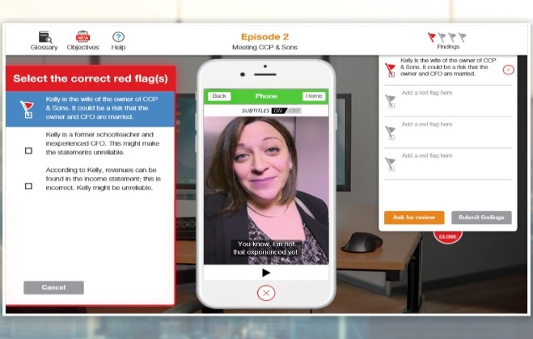
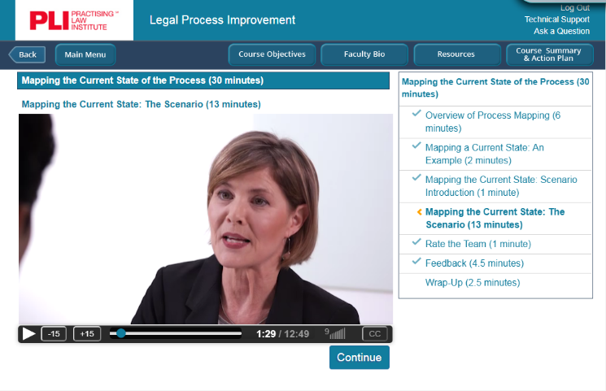

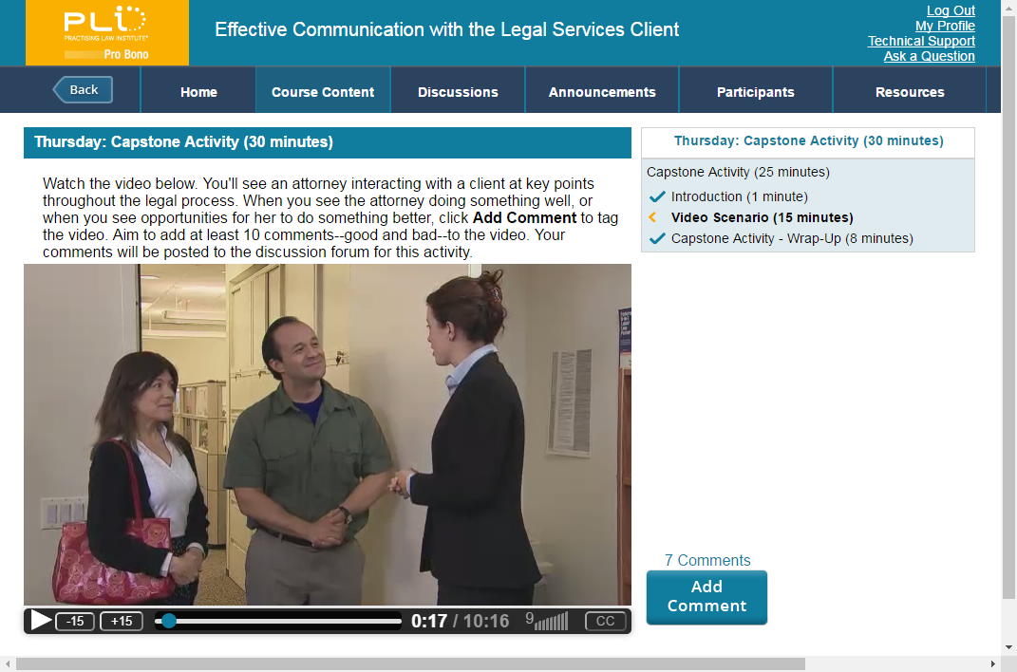
SCENARIO-
BASED
LEARNING
Notes:
We are doing lots of things in a variety of formats, but the common element that ties them all together is scenario-based learning.

Slide 4
SCENARIO-
BASED
LEARNING
But why?
Notes:
Research suggests
Our brains are wired for remembering stories.
Grounding content in stories helps us remember better.
Making decisions in realistic learning contexts serves as rehearsal or practice for real-world application of those skills. Helps people transfer their learned skills to real world situations.

Slide 5
Demos Conducting Internal Investigations improving law firm profitability understanding Financial Statements

Slide 6
Internal investigations GAME
Goal: Conduct an investigation of a sexual harassment charge at a client company and make a report to the General Counsel
Plan and conduct interviews
Conduct fact finding and reporting
Avoid attorney-client privilege problems
Notes:
Avoid attorney-client privilege problems: make sure you include an Upjohn statement as to who you represent.

Slide 7


Slide 8
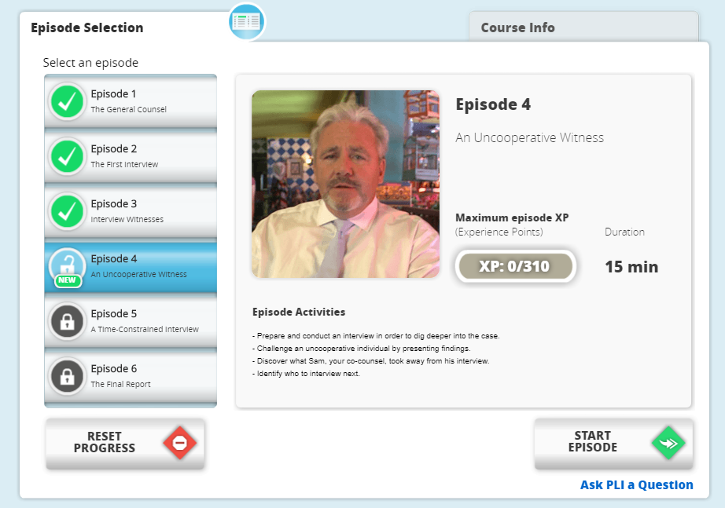

Slide 10
demo
Conduct a successful Interview of the administrative assistant to the Cfo.
The CFO is accused of sexual harassment.

Slide 11
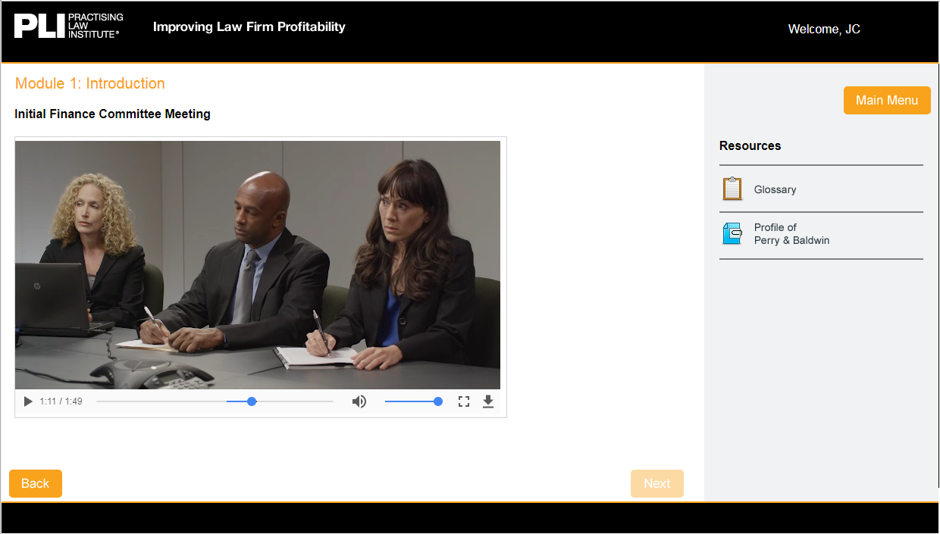
Improving Law Firm Profitability

Slide 12
Improving Law Firm Profitability
Goal: Advise a firm on how to
make profitability improvements.
Identify opportunities
Evaluate expenses
Evaluate revenue
Make suggestions

Slide 13
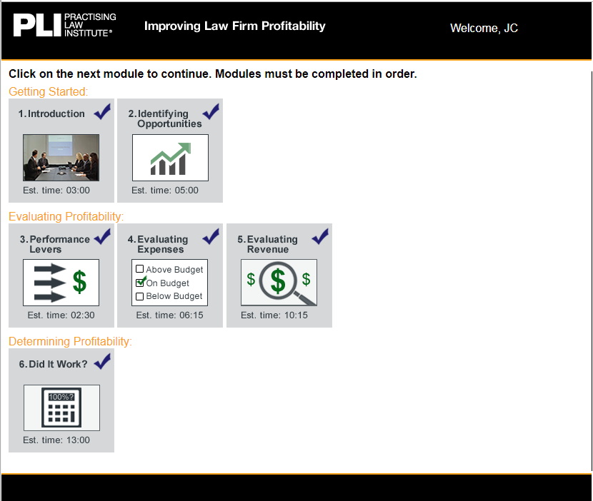
Notes:
Performance drivers are:
Expenses
Overhead
Timekeeper compensation
Revenue
Hours
Rates/pricing
Realization
Leverage non-equity lawyers
------------------------
equity partners

Slide 14
Notes:
Client name is RMC (take off on GMC). Requisite Motor Company.

Slide 15
demo
Evaluate firm Expenses by hearing from attorneys assigned to a client and make a recommendation

Slide 16

The Financial statements game
Goal: Advise a firm client who wants a recommendation on a company to invest in.
Analyze the financials
Interview the principals
Identify “red flags”
Make a recommendation

Slide 17
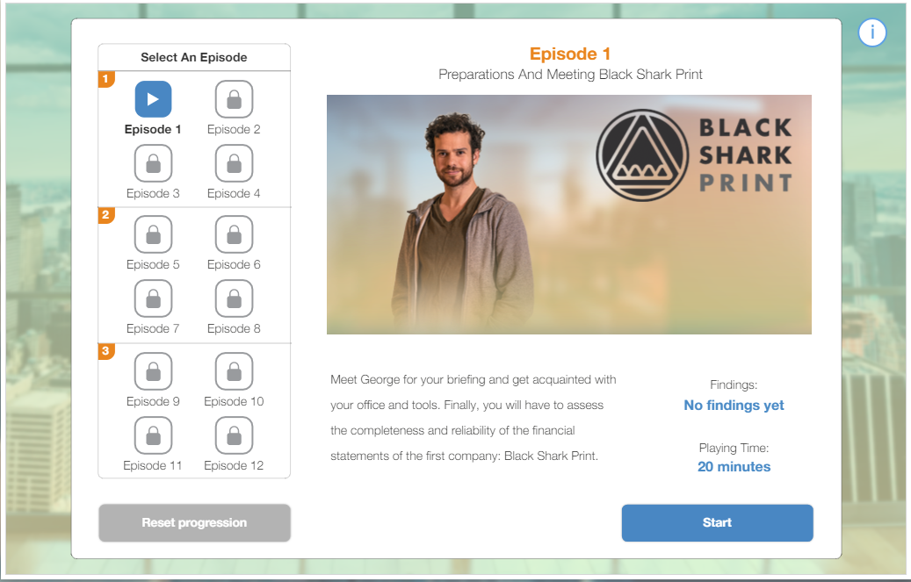

Slide 19
demo
Interview a CFO. Identify any “red flags” that signal problems with the numbers in the financial statements.

Slide 20
Questions?

